Slide 1



AirAware: Air Quality Prediction and Monitoring Dashboard
A Machine Learning based approach to predict and visualize Air Quality
Presented by: Rahul Vangari
Batch: 3
Guided by: Ms.Asma

Slide 2
Project Overview & Purpose
AirAware is an innovative project designed to predict and visualize the Air Quality Index (AQI) using advanced machine learning techniques. Our primary goal is to empower individuals and authorities with actionable insights into air quality trends.
Core Functionality
Purpose
Predicts and visualizes AQI, offering a clear, data-driven perspective on air quality in Indian cities.
Raises awareness, analyzes pollutant trends, and supports informed decision-making for environmental protection.
Technology Stack
Dataset
Developed using Python, Streamlit, Prophet, ARIMA, XGBoost, LSTM, TensorFlow, Pandas, Plotly, Scikit-learn and Matplotlib. VS Code and Google Colab for development.
Uses a cleaned dataset of air quality parameters from various Indian cities, ensuring strong model training.

Slide 3
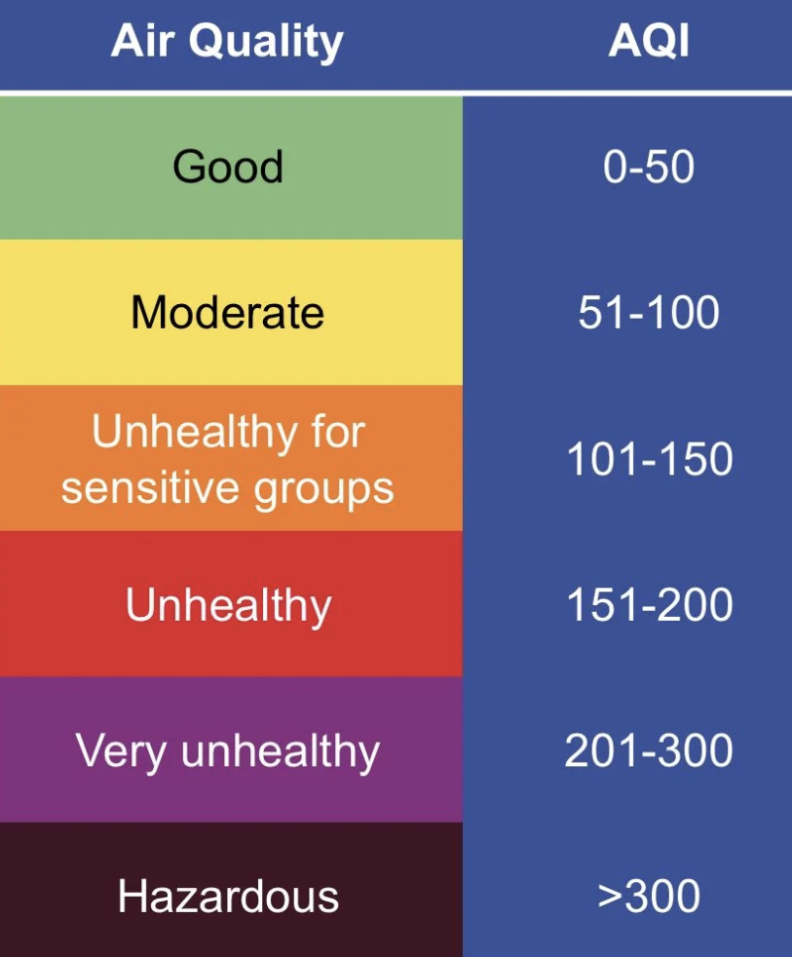

Understanding AQI
The Air Quality Index (AQI) is a crucial metric that simplifies complex air quality data into easily understandable categories, informing the public about potential health risks.
What is AQI?
Key Pollutants
A numerical scale used by government agencies to communicate how polluted the air currently is or how polluted it is forecast to become.
Monitors critical components such as PM2.5, PM10, CO, SO₂, NO₂, O₃, NH₃, and Pb, each contributing to air pollution.
Health Impact Levels
AQI levels range from 'Good' to 'Hazardous', each corresponding to different health implications for the population.

Slide 4
AQI Factor Measurement
Accurate measurement of air pollutants is fundamental to understanding air quality. Various technologies and methodologies are employed to quantify these harmful substances in the atmosphere.
Measurement Units
1
Pollutants are typically measured in micrograms per cubic meter (µg/m³) or parts per million (ppm), depending on the specific gas.
Particulate Matter (PM2.5/PM10)
2
Measured using advanced dust sensors or laser scattering technologies that detect and quantify airborne particles.
Gaseous Pollutants (CO, NO₂, SO₂)
3
Specific gas analyzers and electrochemical sensors are used to precisely monitor concentrations of carbon monoxide, nitrogen dioxide, and sulfur dioxide.
Data Collection
4
Data is systematically collected from sources like the Central Pollution Control Board (CPCB) and through a network of Internet of Things (IoT) sensors deployed across various locations.

Slide 5




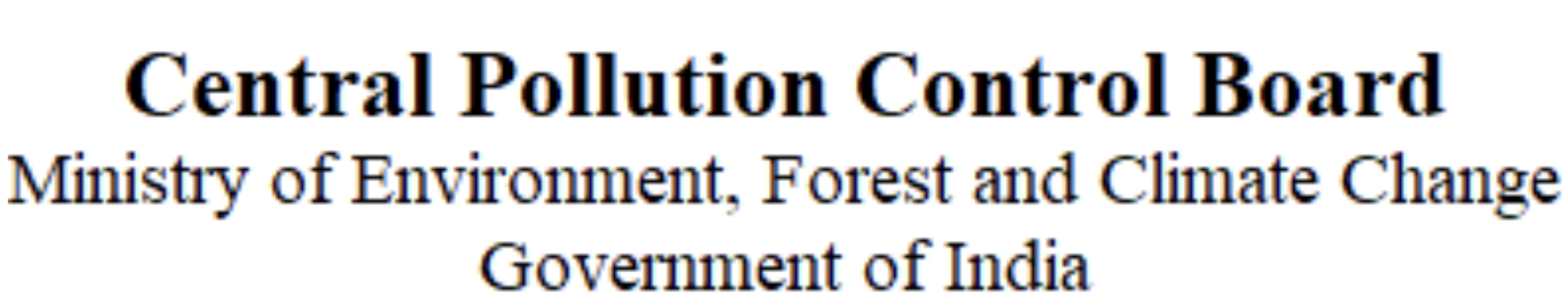
AQI Agencies & Applications
Numerous agencies and mobile applications play a vital role in monitoring, reporting, and disseminating real-time air quality information to the public, fostering greater environmental awareness.
Key Monitoring Agencies
Central Pollution Control Board (CPCB)
System of Air Quality and Weather Forecasting and Research (SAFAR-India)
AQI.in
AirNow
IQAir
These organizations gather and process vast amounts of data from monitoring stations to provide comprehensive air quality reports and forecasts.

Slide 6

Causes & Impacts of Air Pollution
Air pollution stems from diverse sources, leading to severe consequences for human health and the delicate balance of our planet's ecosystems.
Major Contributors
1
Industrial emissions, stubble burning, vehicular exhaust, construction dust, biomass burning, and diesel generators are primary sources.
2
Impact on Humans
Leads to significant health issues including respiratory problems, exacerbated asthma, and increased risk of cardiovascular diseases.
Impact on Earth
3
Contributes to global warming, acid rain, and reduced visibility, disrupting natural environments and climate patterns.
4
Regulated Pollutants in India
Key pollutants under regulation include PM10, PM2.5, CO, SO₂, NO₂, O₃, NH₃, and Pb, reflecting the focus on critical environmental threats.

Slide 7






Solutions & Mitigation Strategies
Addressing air pollution requires a multi-faceted approach, combining individual actions, policy interventions, and technological advancements to foster healthier environments.
Air Purifiers
Electric Vehicles
Indoor air quality improvement through advanced filtration systems.
Reducing vehicular emissions by transitioning to sustainable transport.
Policy & Awareness
Afforestation
Stricter emissions norms and public awareness campaigns drive change.
Increasing green cover to naturally filter pollutants and produce oxygen.
Waste Management
Clean Energy
Implementing efficient waste disposal and recycling to minimize burning.
Shifting from fossil fuels to renewable energy sources to cut emissions.

Slide 8

Project Implementation & Impact
Our AirAware project integrates cutting-edge machine learning with an intuitive dashboard to provide comprehensive air quality insights and foster data-driven environmental awareness.
How AirAware Helps
Predicts AQI trends with high accuracy, offering foresight into air quality.
Displays pollutant correlations, uncovering relationships between various airborne contaminants.
Project Architecture
Provides visual and data-driven insights, making complex environmental data accessible and actionable.
Dataset
Technology Stack
Preprocessing
Built on Python, Streamlit for the user interface, and powered by Machine Learning models including ARIMA, Prophet, XGBoost, and LSTM for robust prediction.
ML Models
Prediction
Steps to Run
Load cleaned_air_quality.csv into the project directory.
Execute streamlit run app1.py and streamlit run app2.py in your terminal.
Access and explore the comprehensive dashboards (M1–M4) in your web browser.

Slide 9
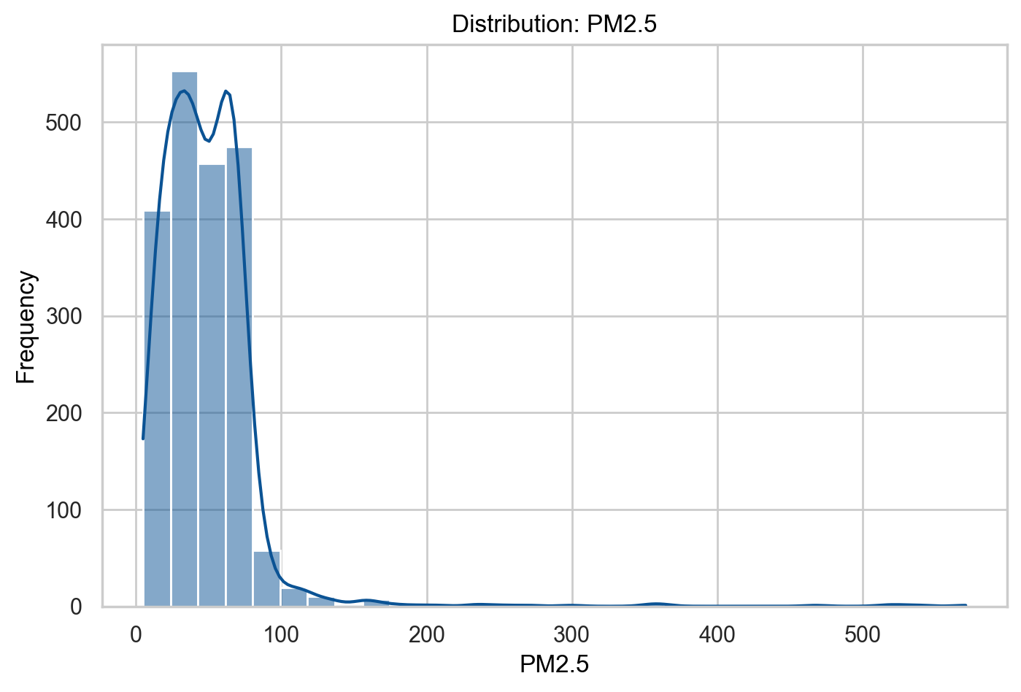
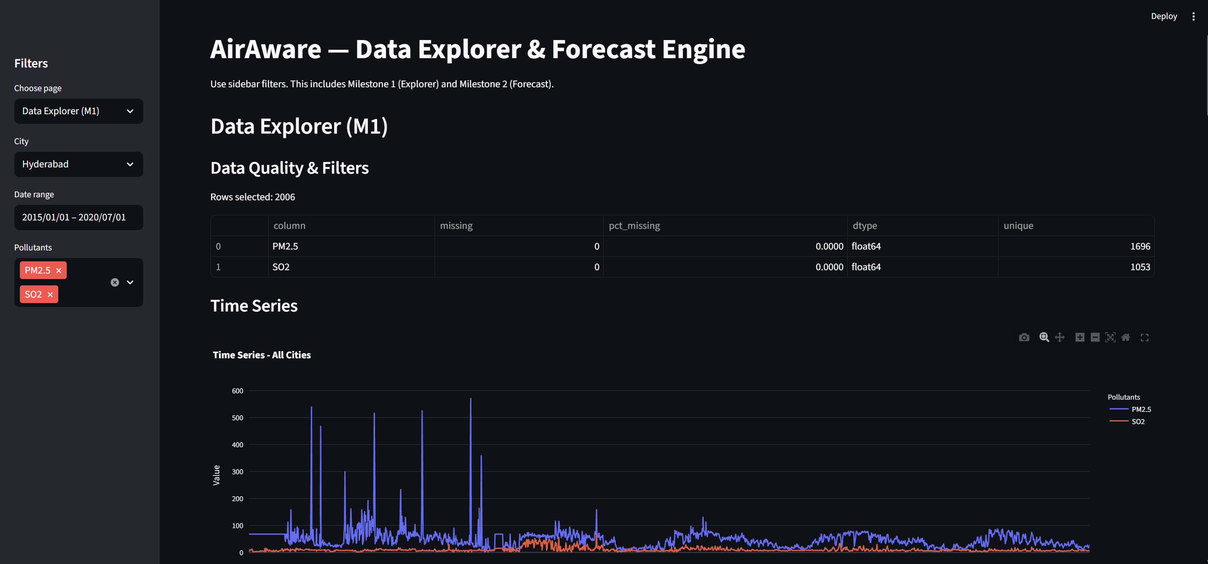
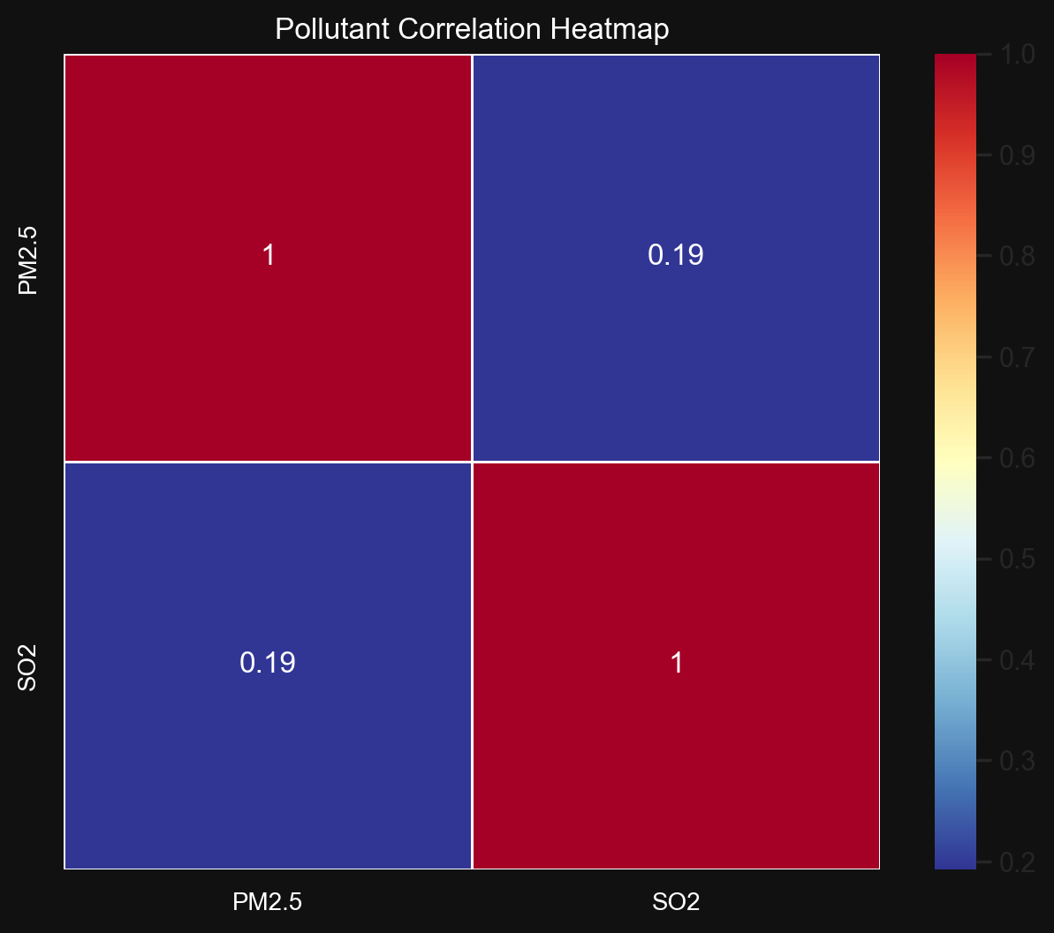
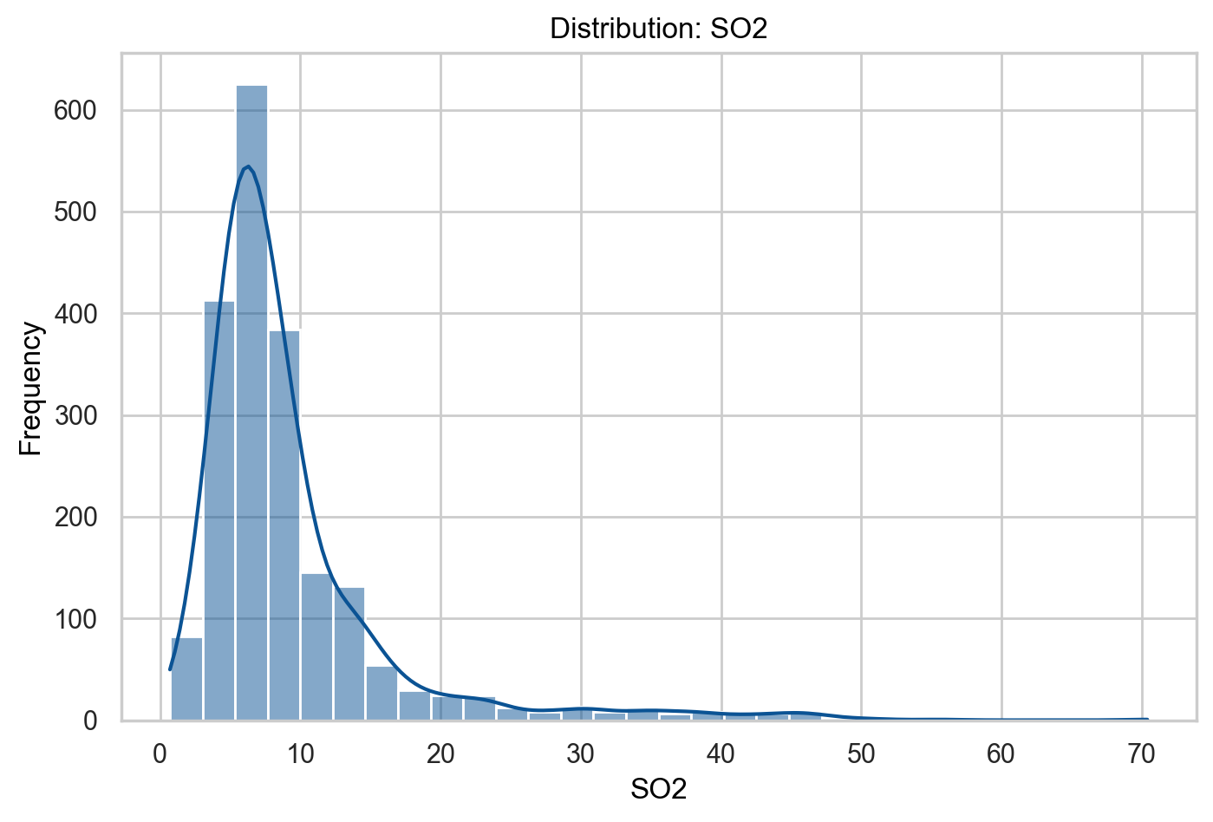
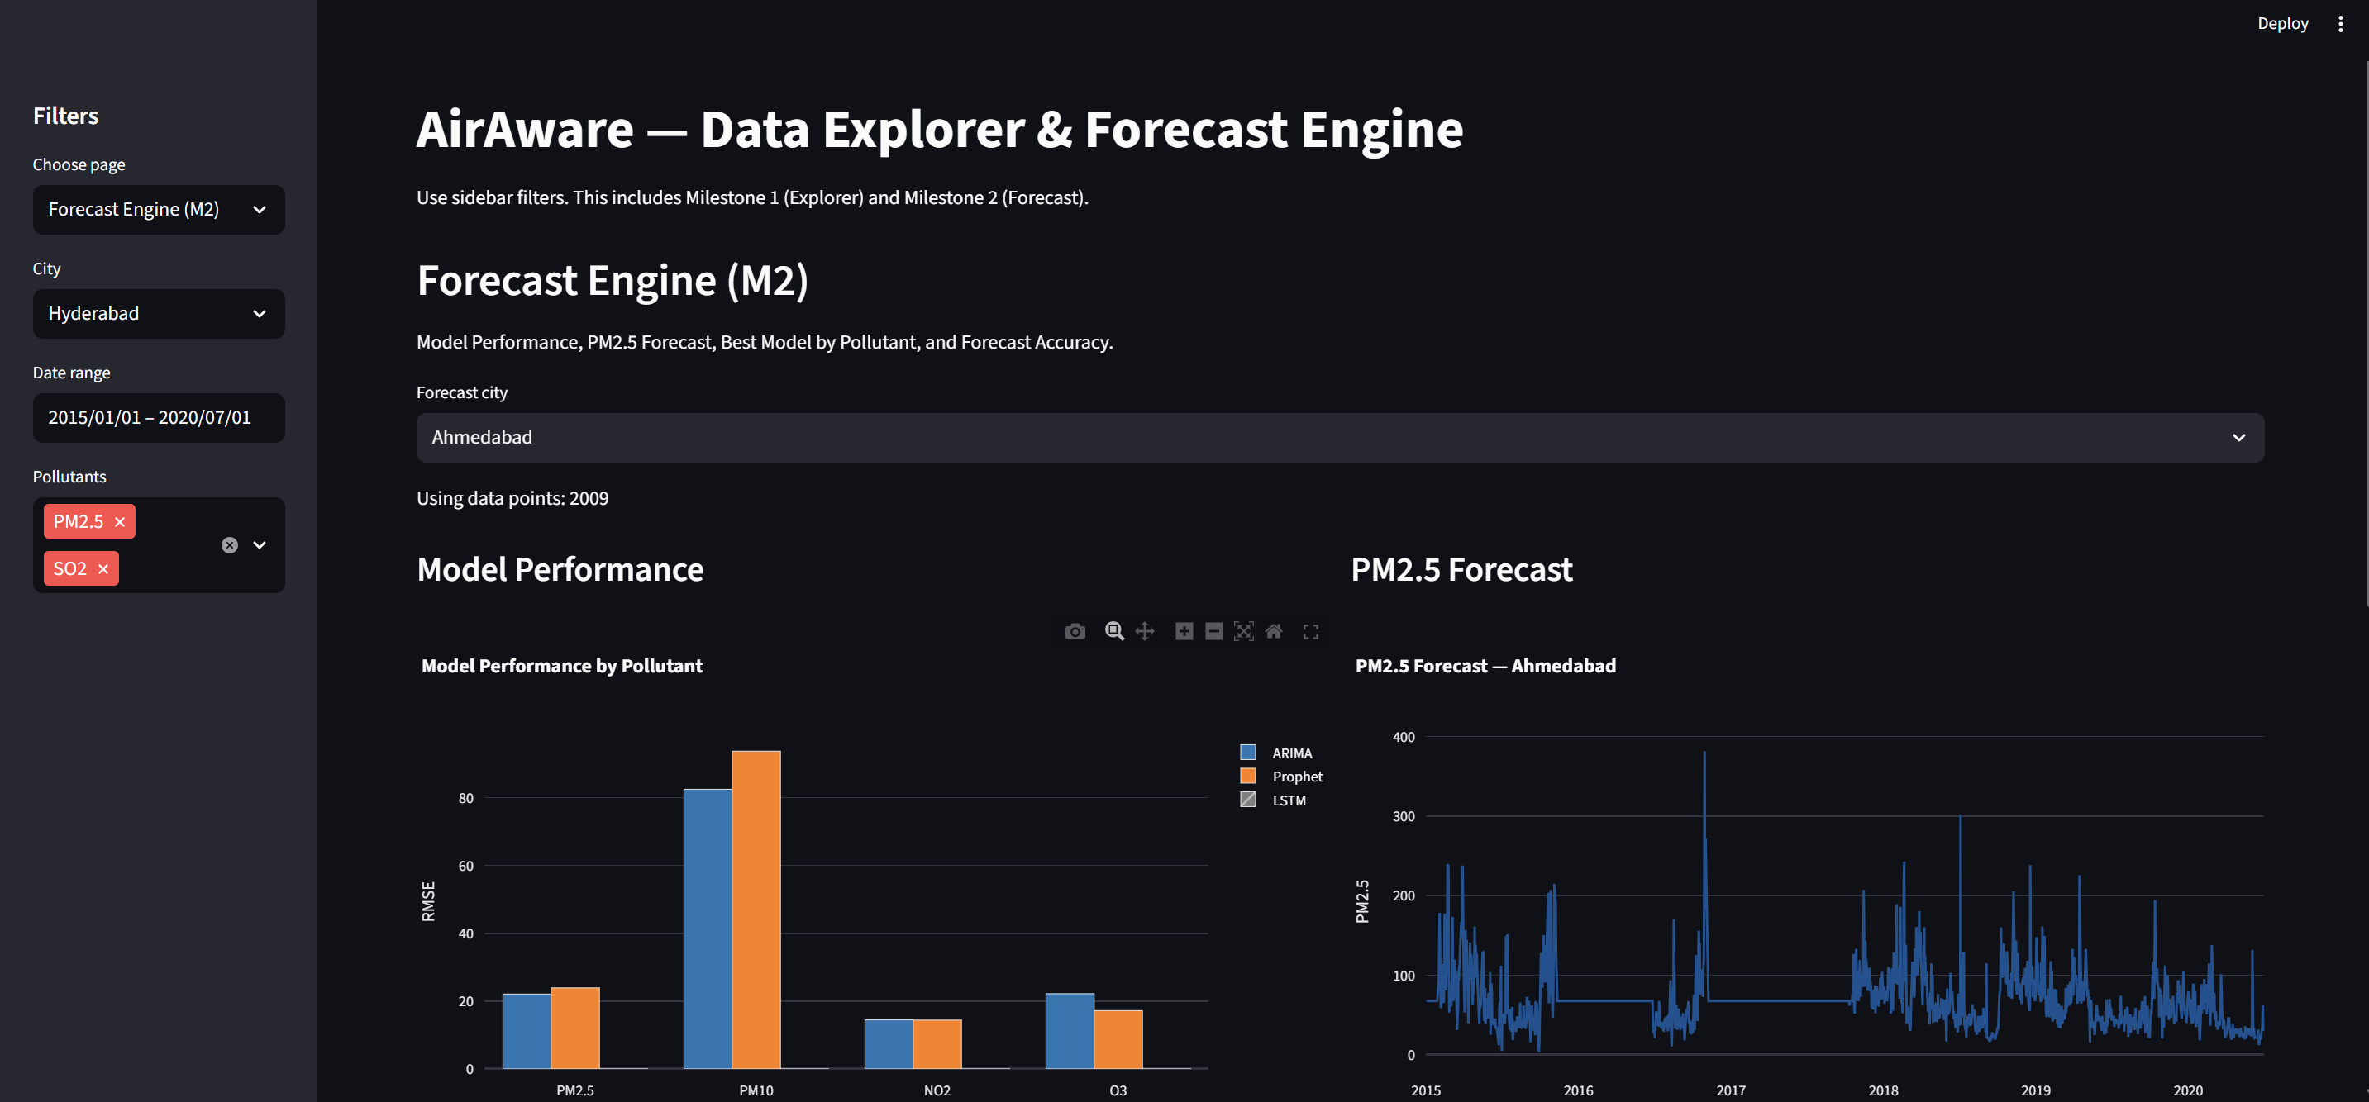
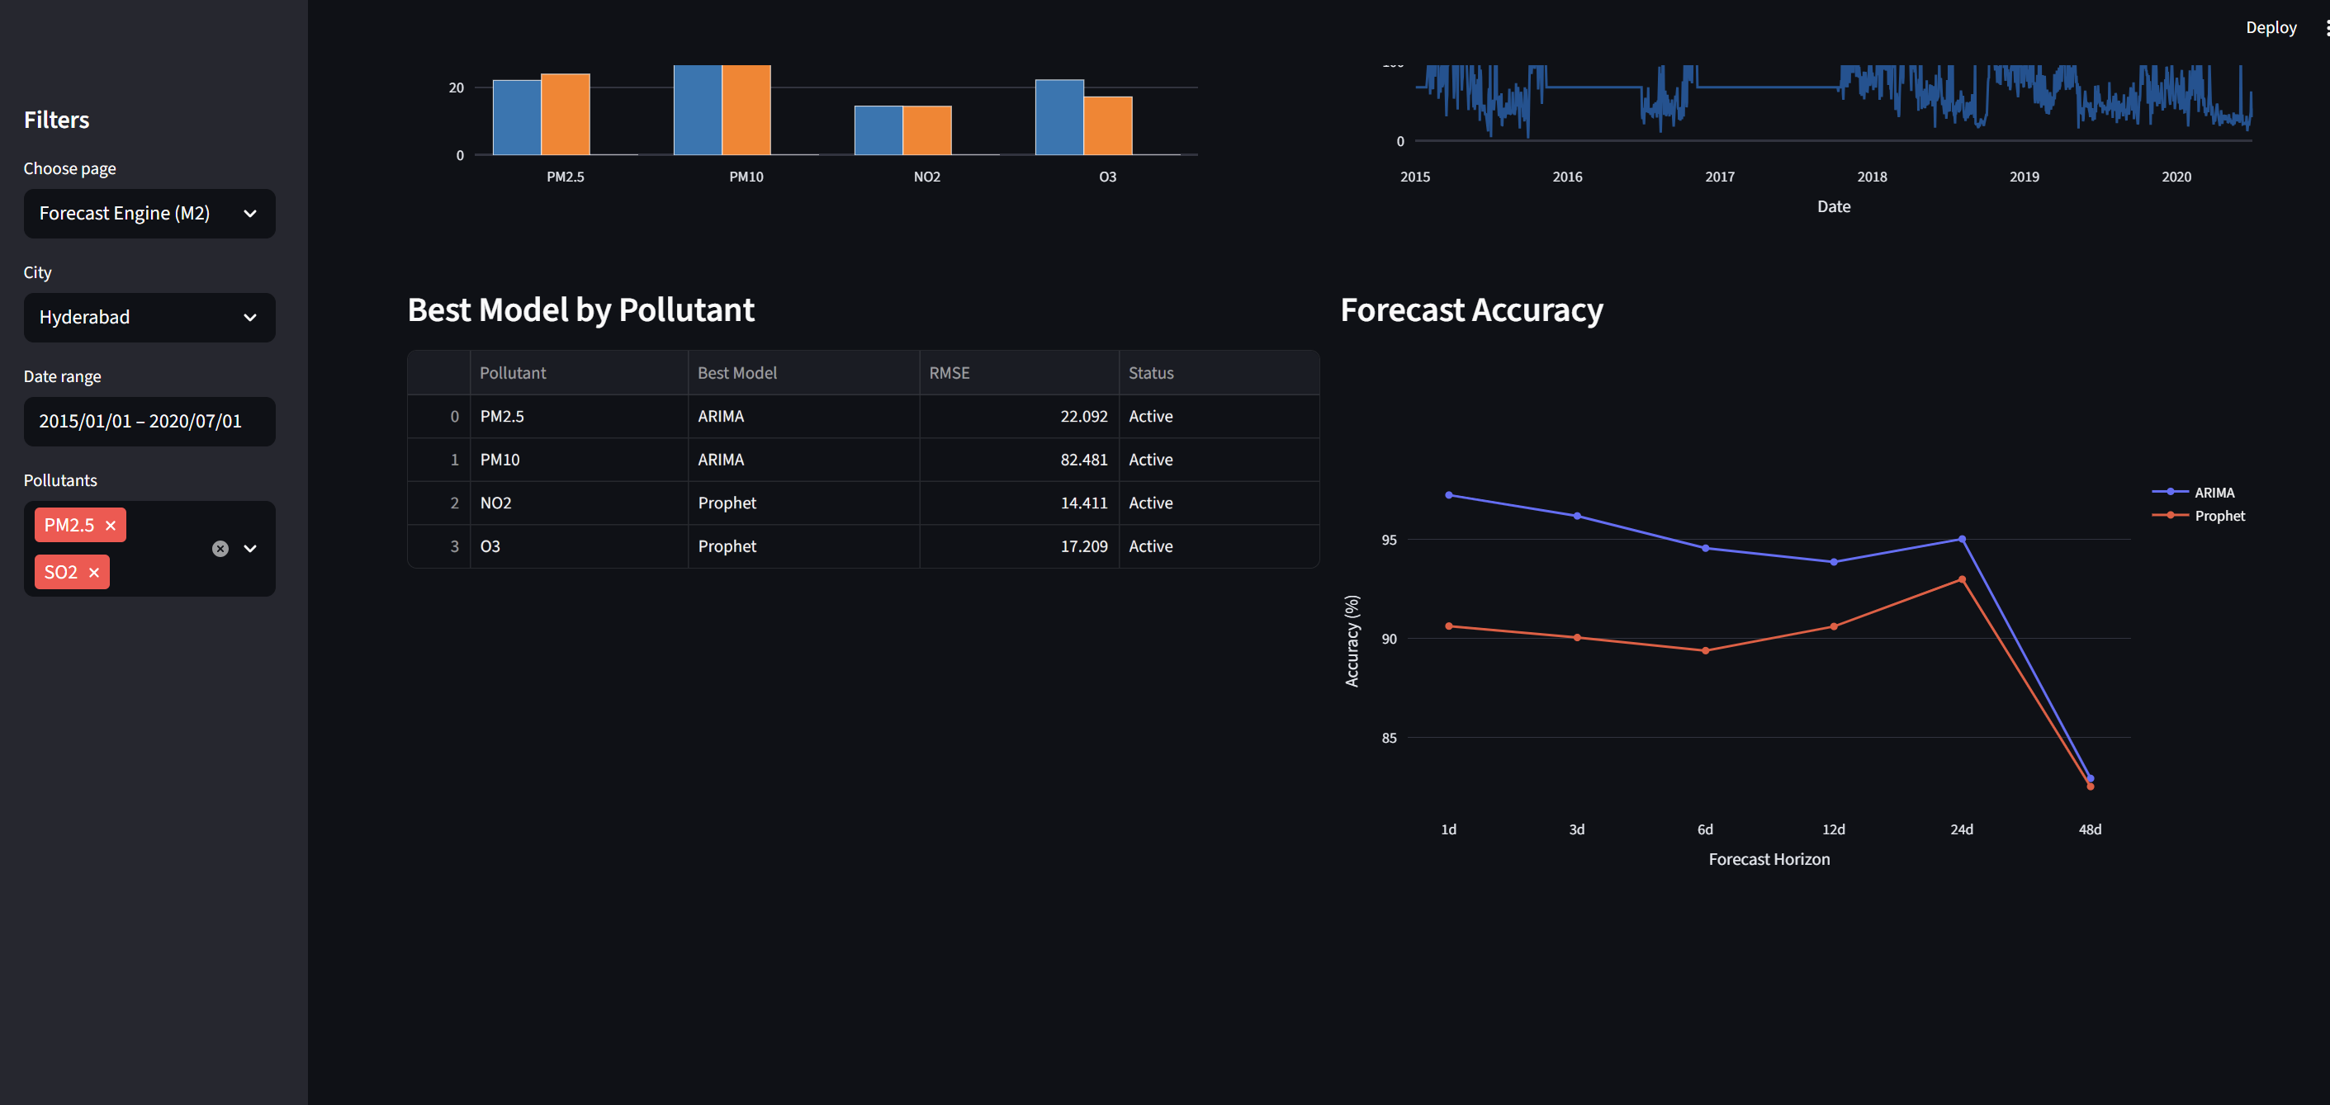
Project Dashboards:
MILESTONE 1:
MILESTONE 2:

Slide 10
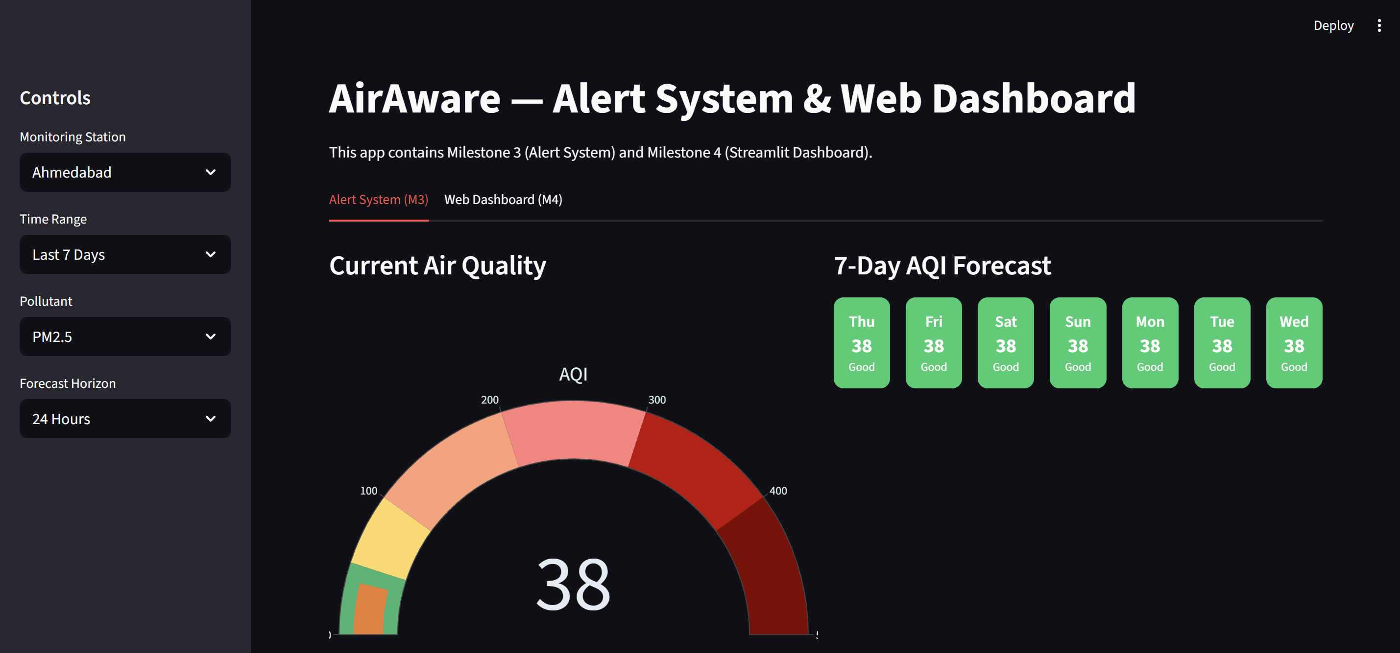
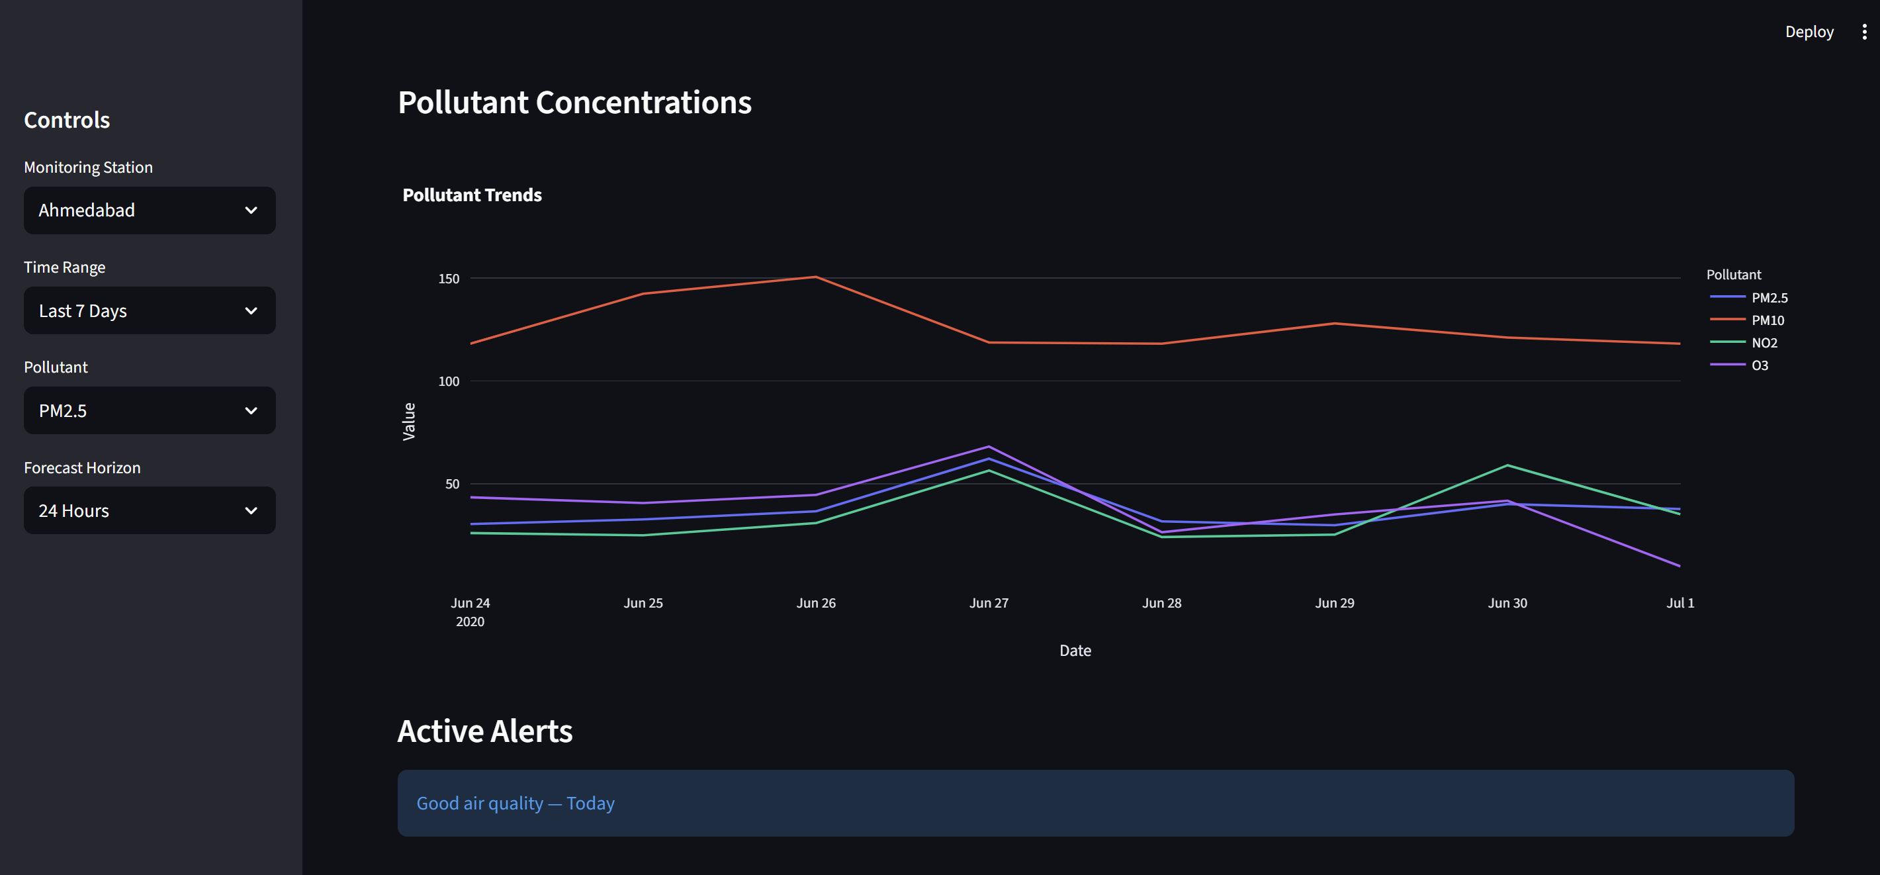
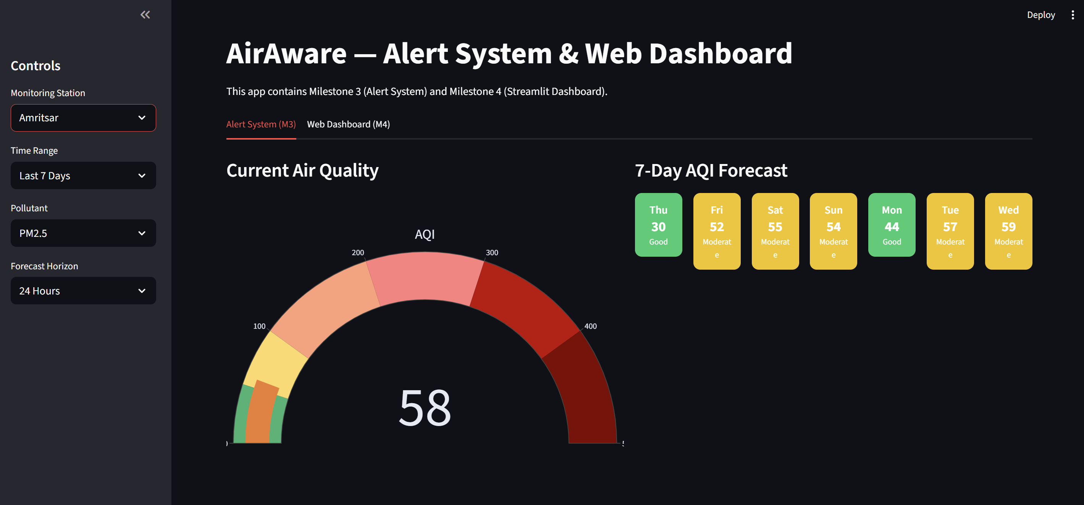
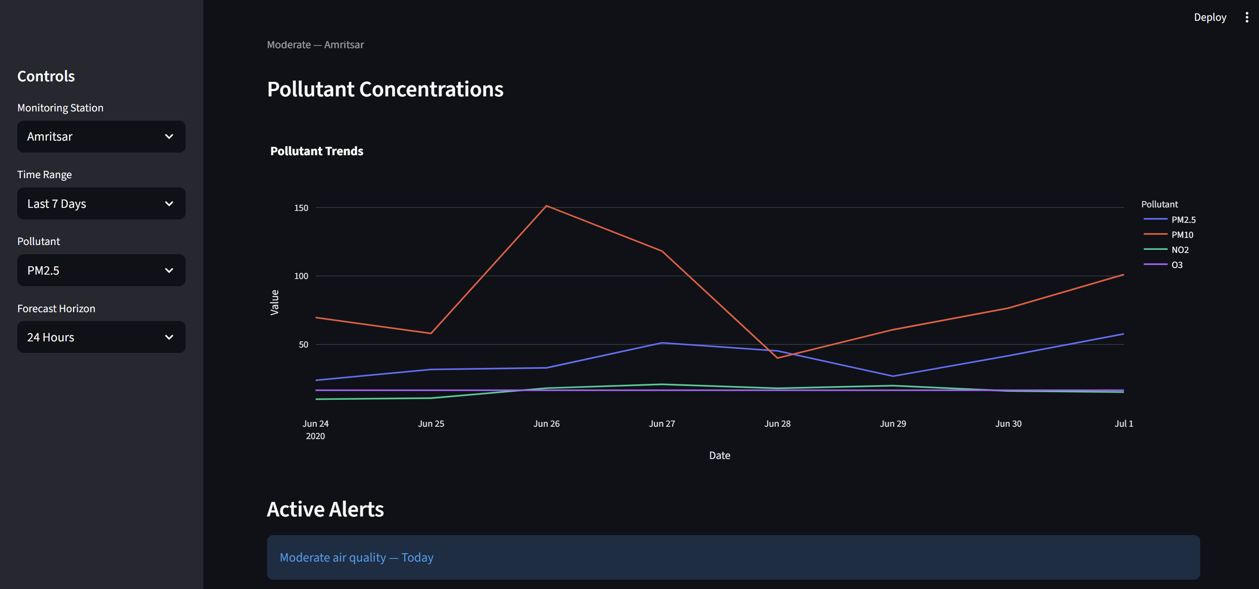
MILESTONE 3:
MILESTONE 4:

Slide 11



Conclusion
AirAware helps in addressing critical environmental challenges. By providing accessible and accurate air quality insights, we aim to empower communities and drive sustainable change.
AirAware contributes to cleaner, data-informed environmental awareness.
Thank You

